Slide 2
Orchestrate MLOps by using Azure Databricks
Responsibility, Testability and Reusability
Notes:
Time: 1 min

Slide 3

Anand Chugh
Sr. Software Engineer, Microsoft
Notes:
Time: 1 min

Slide 4

Prabal Deb
Sr. Software Engineer, Microsoft
Notes:
Time: 1 min

Slide 5
Problem Statement
NYC Yellow Taxi would like to predict their taxi fares for upcoming rides to enable more profits for drivers. They do not want to run real-time prediction, instead they want to have a batch prediction done for each month and use to in their driver application.
Data Scientist Team worked hard to solve this problem and created a Notebook to demonstrate the solution to the SME. Engineering Team that manages driver application was excited to see the outcome and wanted to have this included in driver application.
Engineering Team decided to use Azure Databricks to implement the solution and started putting an architecture that can run a Machine Learning (ML) model in Production.
Notes:
Time: 3 Min

Slide 6
Problem Statement
Engineering Team started seeing some of the following problems -
The ML Model is not something that is created one time and can be used forever, there will be continuous experimentation, development and evolution done by Data Scientist Team.
The codebase that includes Data Science Code (ML Code) and other code that enable ML Model to run (MLOps Code) will be developed in parallel by two different teams, Data Science Team and Engineering Team.
Without enabling Unit Testing in development/CI-Pipeline and E2E Integration Testing of Training and Batch Scoring Pipelines, it’s becoming difficult to maintain quality deliverables.
Tasks that deals with lots of data (feature engineering), take longer time and resources.
Hence Engineering Team started adopting MLOps best practices to overcome these problems.
Notes:
Time: 2 Min

Slide 7
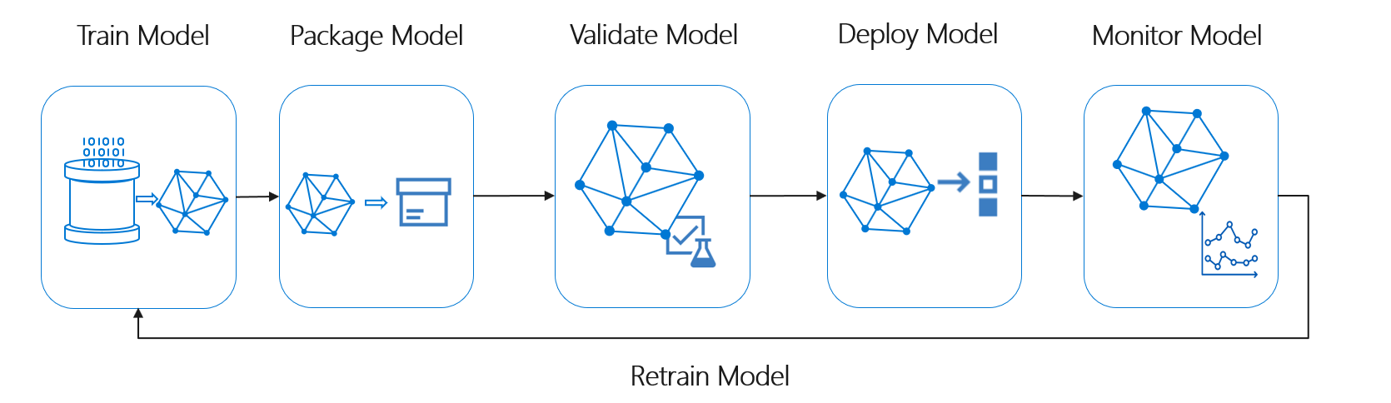
MLOps Stages
https://learn.microsoft.com/en-us/azure/architecture/example-scenario/mlops/mlops-technical-paper
Notes:
Time: 2 Min

Slide 8
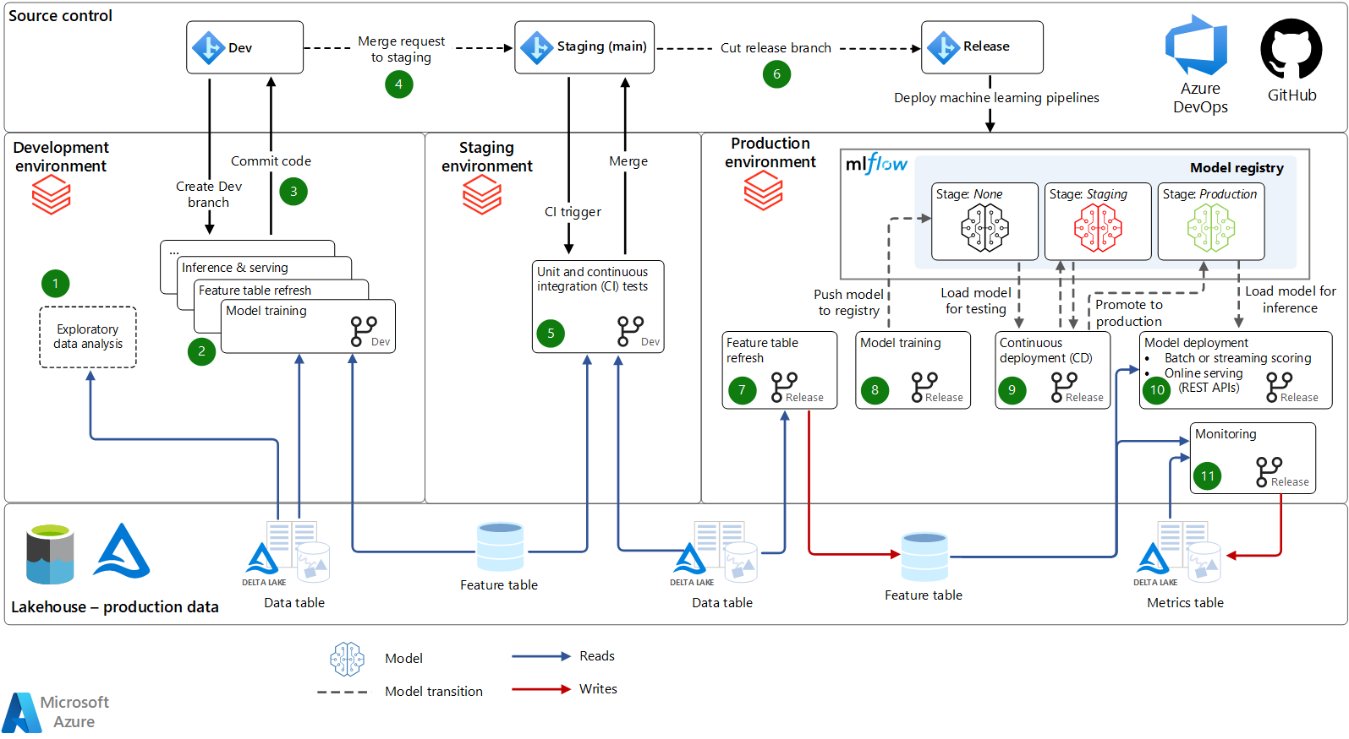
MLOps Stages Deep Dive
https://learn.microsoft.com/en-us/azure/architecture/reference-architectures/ai/orchestrate-mlops-azure-databricks
Notes:
Time: 3 Min

Slide 9
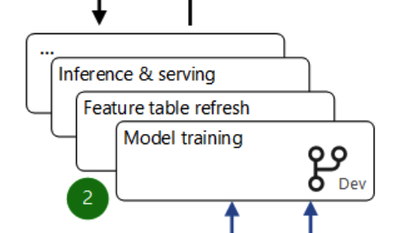
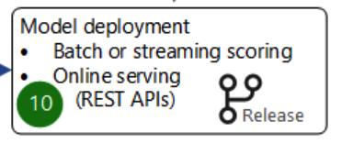
MLOps Stages Deep Dive
https://learn.microsoft.com/en-us/azure/architecture/reference-architectures/ai/orchestrate-mlops-azure-databricks
Notes:
Time: 1 Min

Slide 10
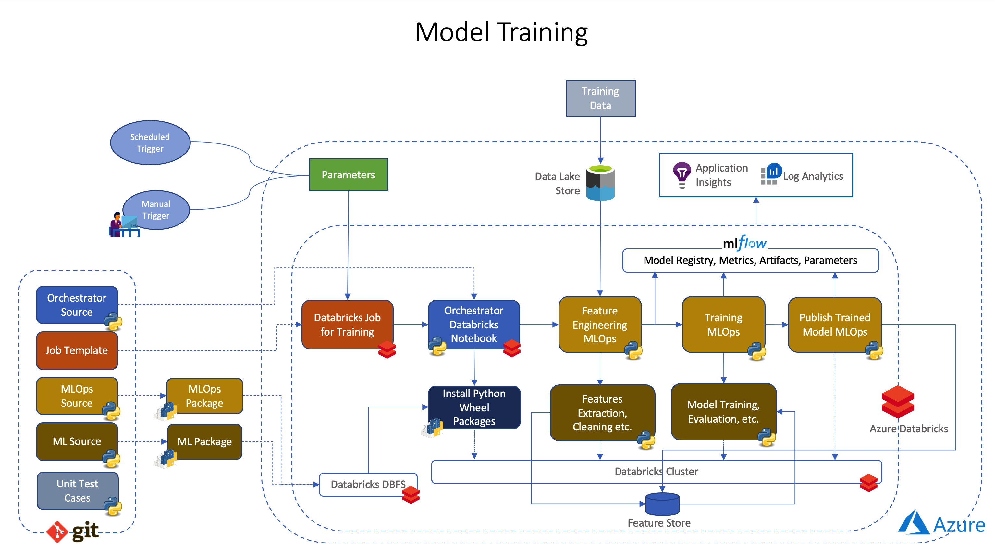
Orchestration of Model Training
Notes:
Time: 3 Min

Slide 11
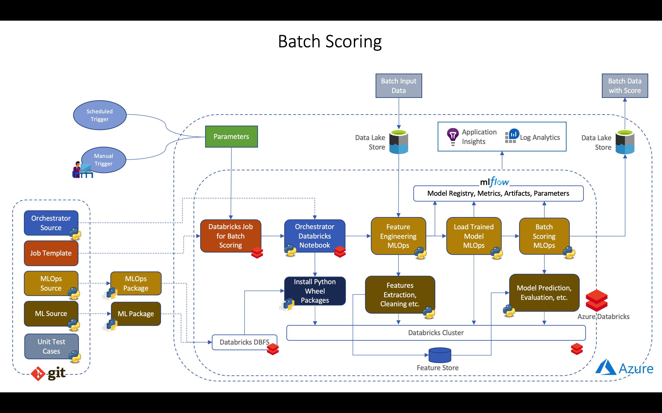
Orchestration of Batch Scoring
Notes:
Time: 2 Min

Slide 12
Responsibility
Separate Python Packages for ML
Developed and maintained by Data Science Team
Separate Python Package for MLOps
Developed and maintained by Engineering Team
Notes:
Time: 1 Min

Slide 13
Testability
Unit Testing for ML Code
Unit test of ML code that can be executed in development and CI pipeline
Unit Testing for MLOps Code
Unit Test of MLOps that can be executed in development and CI pipeline
Integration Testing for Databricks Orchestrator
End to end integration testing of training, batch scoring using framework like Nutter
Notes:
Time: 1 Min

Slide 14
Reusability
Reusable Feature Engineering Data
Optional Feature Engineering Stage with a simple flag in Databricks Job Parameter
ML Model faster training cycles
Easy hyperparameter tunning using Databricks Job Parameter
Reusable Compute resources
Same Databricks cluster can be used for multiple purpose using Notebook scoped library
Reusable ML and MLOps Code
Notes:
Time: 3 Min

Slide 15
Demo of Orchestration

Slide 16
How to re-use this template
Fork the sample code base (Azure-Samples/azure-databricks-mlops-mlflow) from GitHub
Replace the taxi_fares module from ml_source/src folder with your ML source code module
Similarly replace the taxi_fares module from ml_ops/src folder with your MLOps code module
Modify the Orchestrator Notebooks accordingly under ml_ops/orchestrator folder
Modify the Databricks Job Templates under ml_ops/deployment/databricks folder
Add unit test cases for the ML and MLOps code under test folder along with code base
Notes:
Time: 1 Min

Slide 17






Platinum Partner
Gold Partner
Silver Partner

Slide 18
Q & A

Slide 19
Thank You!
Orchestrate Stages of MLOps using Azure Databricks
Anand Chugh
Sr. Software Engineer, Microsoft
Prabal Deb
Sr. Software Engineer, Microsoft

